Slide 1
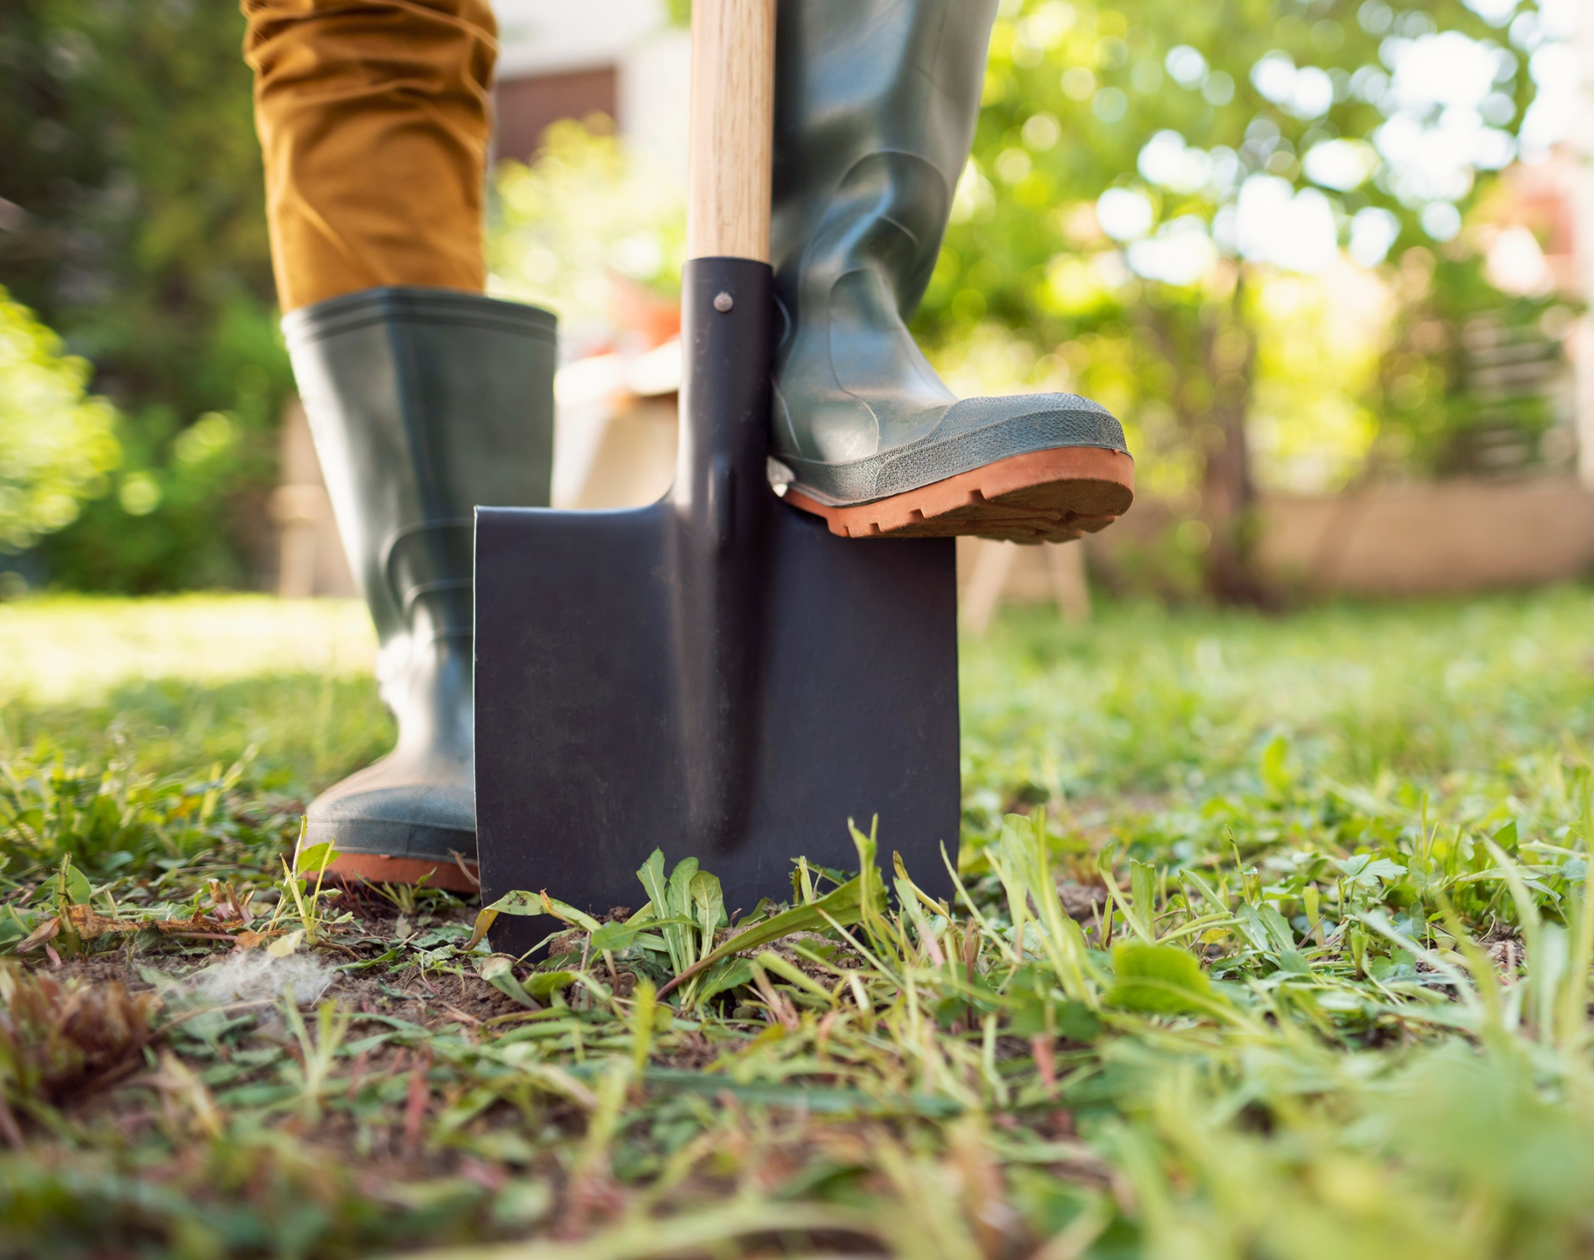
Digging into Biochar
Carbon removals in agricultural using charcoal

Slide 2



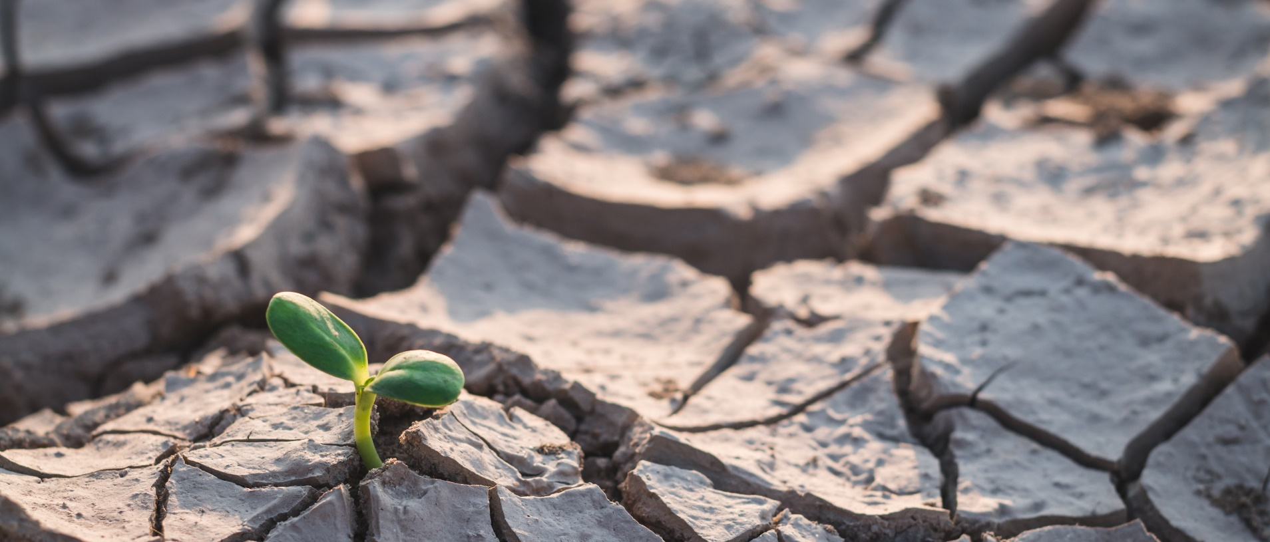
Carbon removals! Why bother?
Climate change, mostly.

Slide 3
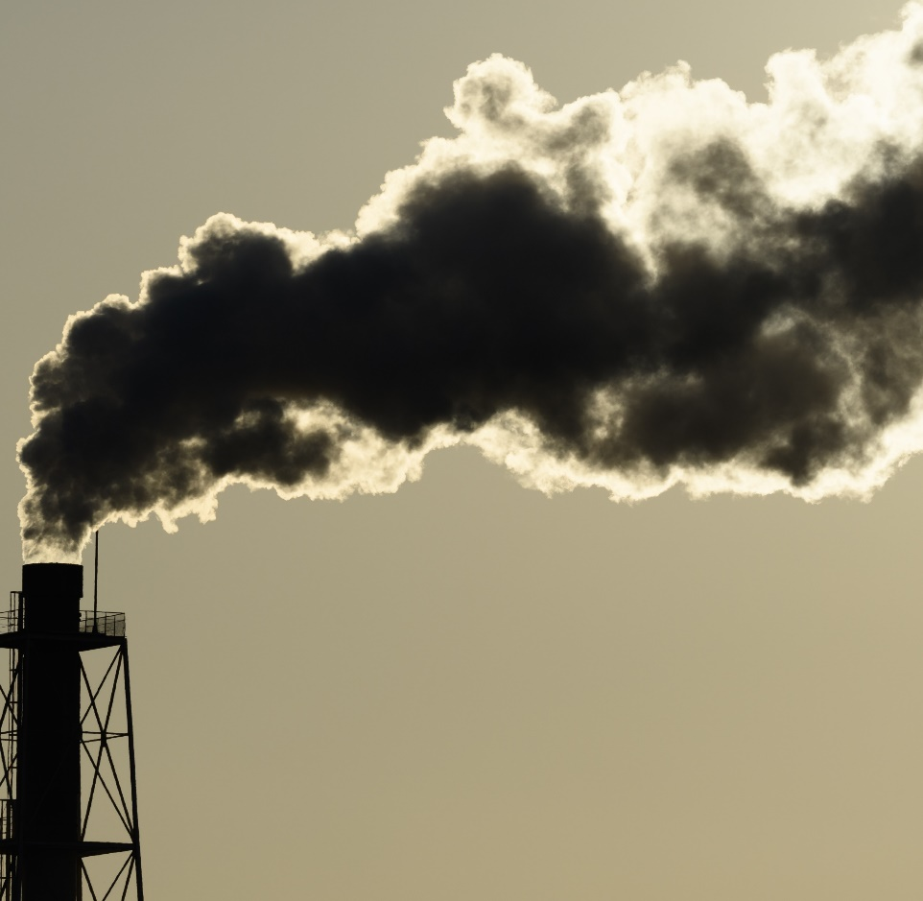
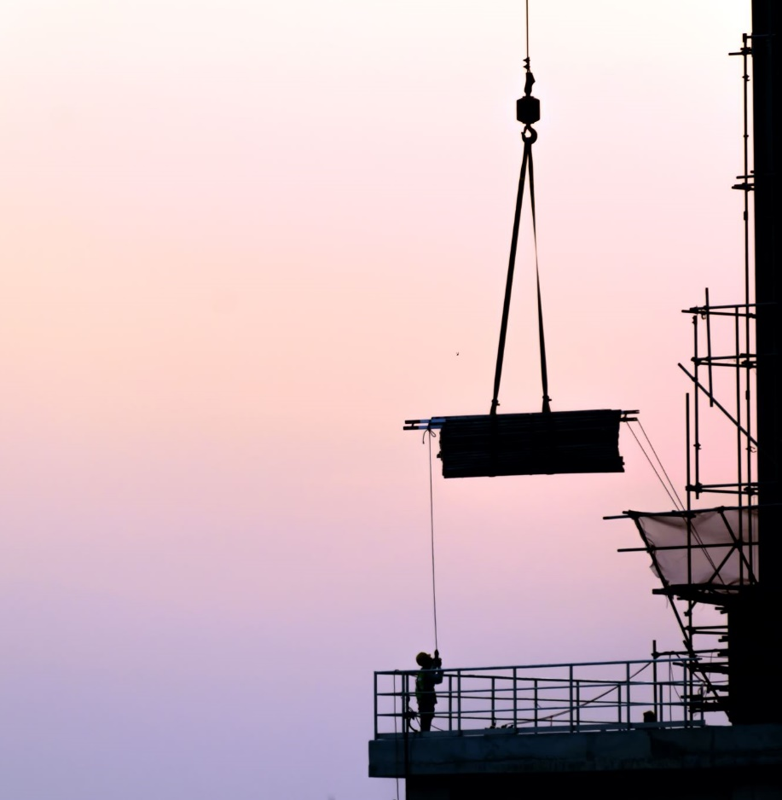


So, stop polluting?
Yes, but…
“Not all emissions can be avoided.” – IPCC, 2023

Slide 4
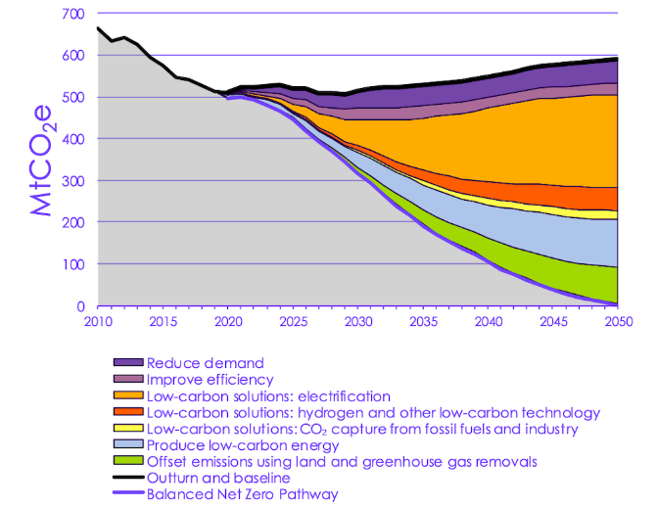
“Achieving net zero CO₂ emissions globally… requires deep emissions cuts… along with active removal of CO₂”
– IPCC 2023
Emissions reductions/removals by 2050 (CCC)

Slide 5
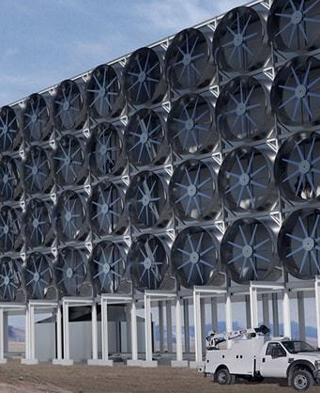
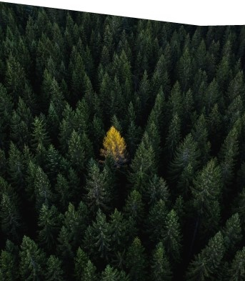
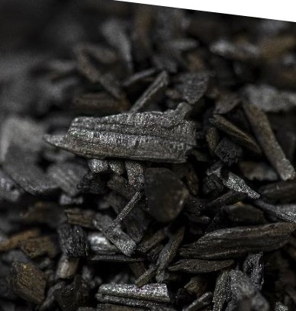
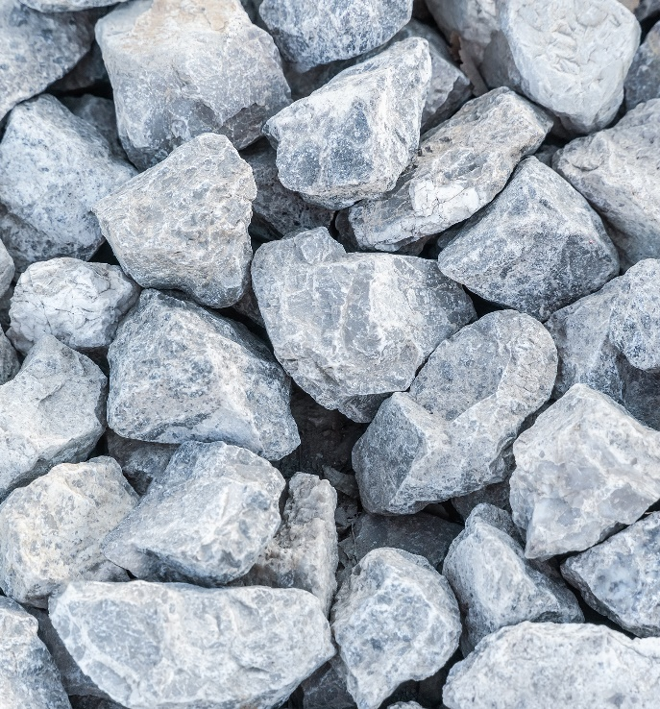
Carbon removals
From nature-based to high-tech solutions

Slide 6
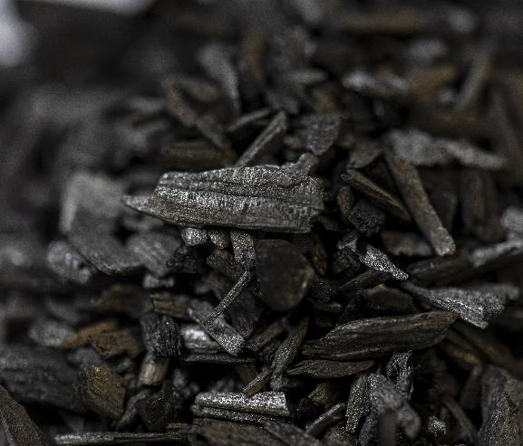
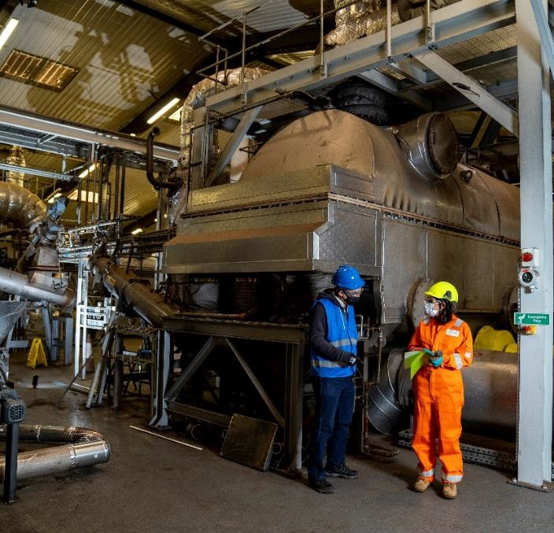
What is Biochar?
Biochar is a stable, carbon-rich material produced from heating plant matter in the absence of oxygen.
It can be used to store carbon in soil or other materials for thousands of years.

Slide 7
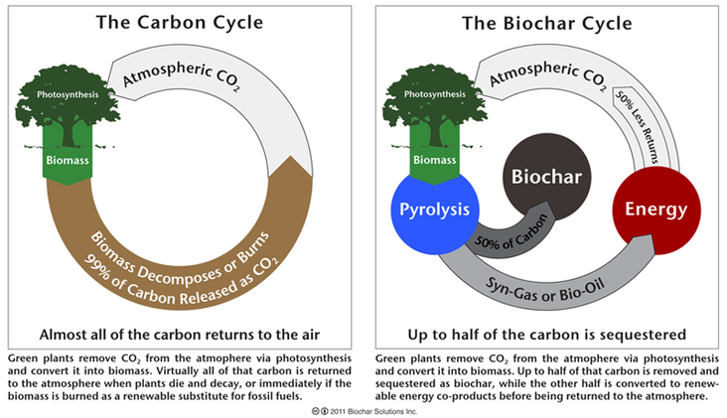
How does Biochar remove carbon?

Slide 8
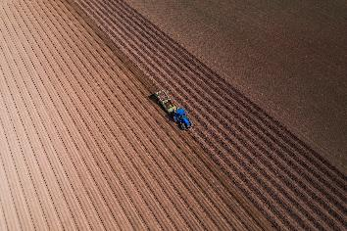
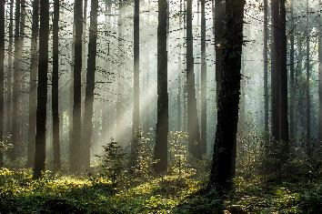
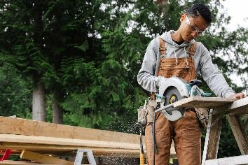
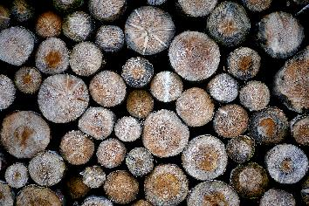

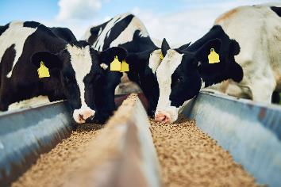
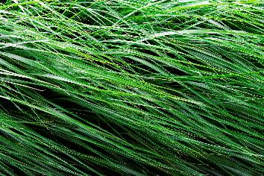
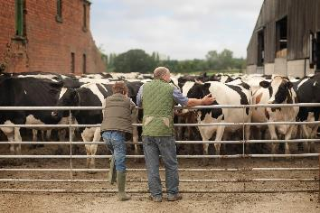


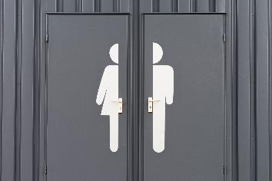

What can you make it from?
What can you use it for?

Slide 9
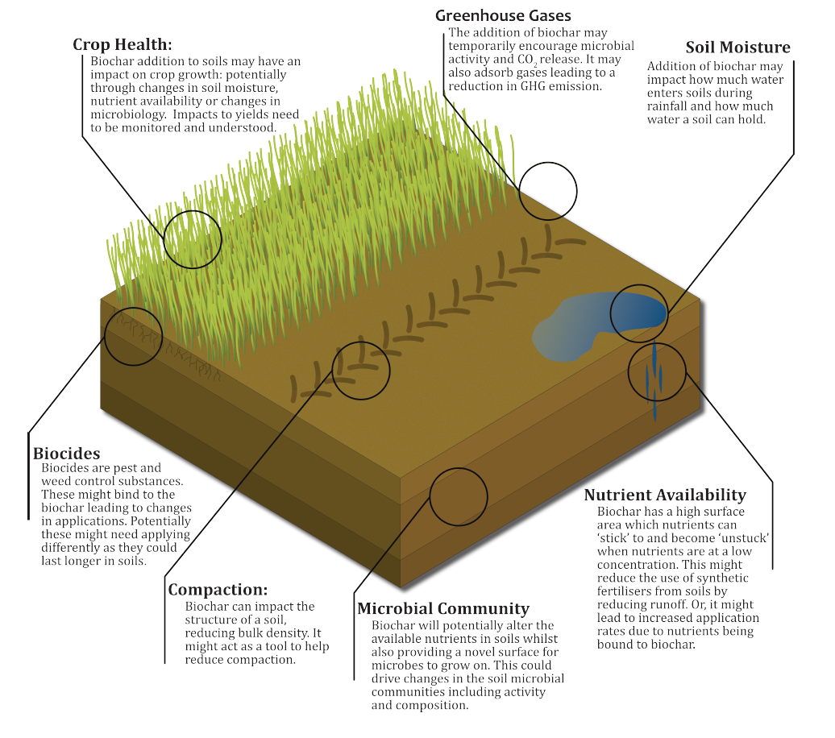
Why might you use Biochar in soils?

Slide 10
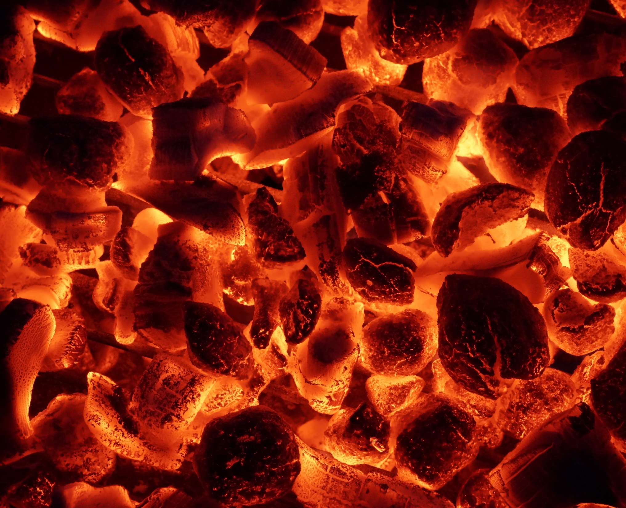
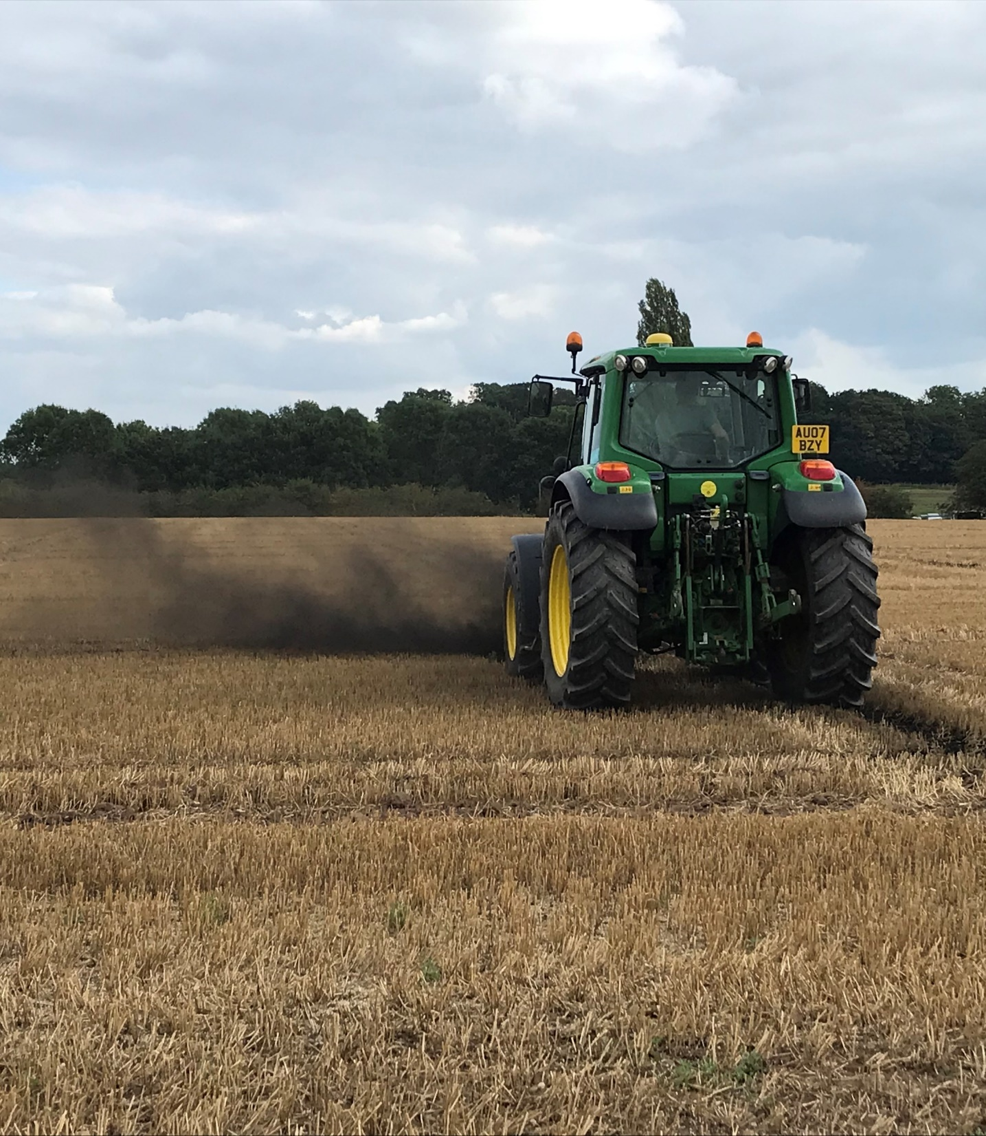
What are the risks of Biochar?
| Dust
Fire
| Environmental Harm

Slide 11
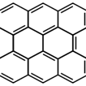
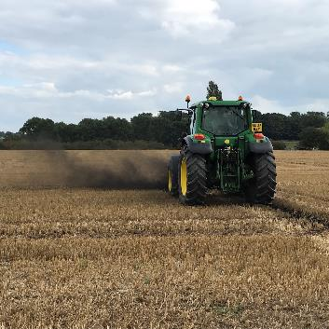
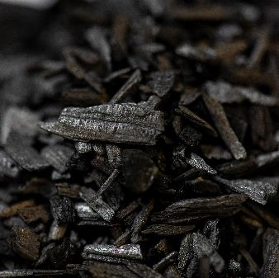
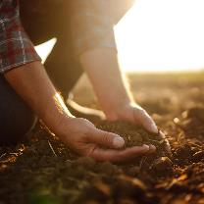
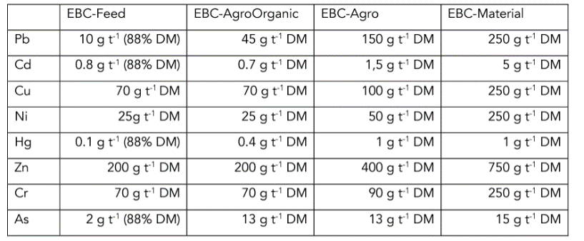

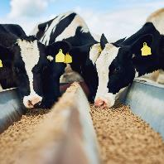
What makes ‘good’ biochar?
Physical Properties
Carbon Stability &
Permanence
Particle Size
Risk of
Environmental Harm
Porosity

Slide 12







Our Goal:
Unravelling uncertainties
for biochar as carbon sequestration in UK soils
Field Deployment
Stakeholder Perspectives
Flexible Fund
Gap-filling Projects
Lifecycle Assessment & Techno-Economic Analysis
Biochar Characterisation

Slide 13
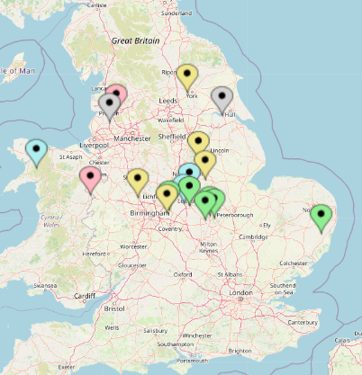
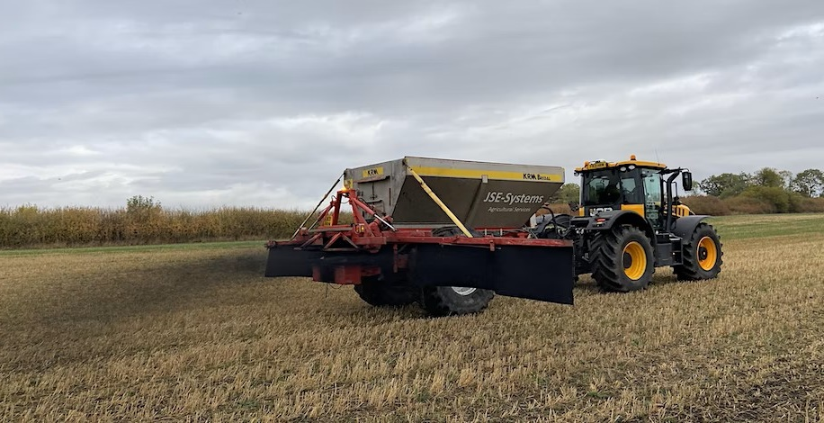





Research Trials:
10 t/ha; 150+ tonne
7 Partner farms (+ 2 research projects)
3 University farms
2 Forests
5+ year monitoring
Deployed Farm Sites
Deployed University Sites
Potential Farm Sites
Deployed Partner Sites
Deployed PBC4GGR Sites

Slide 14




@TheBiocharDemo
The Biochar Demonstrator
biochardemonstrator.ac.uk
Newsletter

